Slide 1
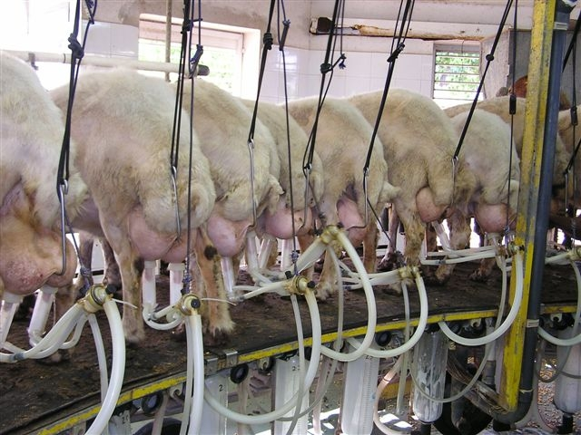
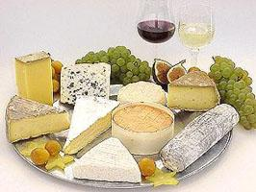
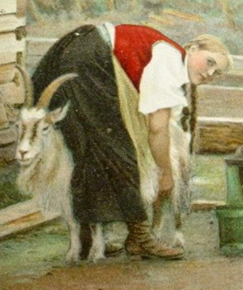
Major causes affecting raw milk composition
and its procession into curd in sheep and goats

Slide 2
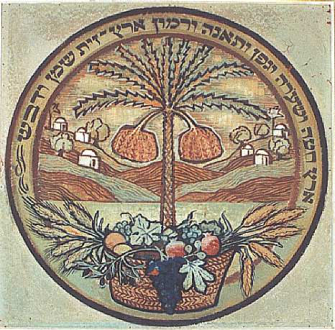

Dr. Nissim Silanikove
Biology of lactation Lab.
Agricultural Research Organization,
The Volcani Center, Israel
Dr. Uzi Merin, Dr. Gabriel Leitner
National Mastitis Reference Center,
Kimron Veterinary Institute, Israel
Agricultural Research Organization,
The Volcani Center, Israel

Slide 3
Milk quality:
fat, total proteins, casein,
curd and…..
intramammary Infection, stage of lactation
Cheese quality:
yield, structure, smell, flavor,
shelf life …..

Slide 4
CASEINOLYSIS INDEX
Infected gland
~ 3,000,000
Cell depended
Healthy gland
~ 50,000 Cows
~ 300,000 goats and sheep
Bacteria and Cells depended

Slide 5

Bacterial infection may affect
caseinolysis and micelle properties
by three main routes:
1. directly, by secreting extracellular enzymes
different bacteria will cause different "type"
of physico-chemical damage to the milk
Cork 2005

Slide 6
2. activate the host innate immune system
milk from different type of bacteria with similar
SCC will result in similar damage to the milk
3. a combination of 1 and 2
Cork 2005

Slide 7

Aim: to calculate the losses of milk and cheese loss as
related to the level of subclinical udder infection in a herd.
Elucidated the major factors that influence milk yield and,
consequently, curd yield in Assaf sheep and Saanen and
Shami × Anglo-Nubian goats,

Slide 8
CMT and log SCC in uninfected and infected
udders and their different significance level (LS Means with (P [F]).
Goats | Sheep | Bacteriological Status
Log SCC | CMT | Log SCC | CMT
5.51 ^{b} | 0.91 ^{b} | 5.33 ^{b} | 0.65 ^{b} | Uninfected
6.12 ª | 1.59 ª | 6.38 ª | 2.23 ª | Infected
0.0001 | 0.0001 | 0.0001 | 0.0001 | P [F]

Slide 9
Fat, protein and lactose in uninfected and
infected udders and their different significance level (LS Means((P [F]).
Goats | Sheep | Bacteriological Status
Lactose | Protein | Fat | Lactose | Protein | Fat
45.9 ª | 38.1 | 37.4 ª | 49.4 ª | 49.0 ^{b} | 55.9 | Uninfected
44.0 ^{b} | 38.3 | 35.1^{b} | 42.9 ^{b} | 50.3 ª | 56.9 | Infected
0.0001 | NS | 0.04 | 0.0001 | 0.0001 | NS | P [F]

Slide 10
Quantifying the damage caused by IMI with CNS
From data collected in the present study and those published recently
two equations could be developed to calculate milk yield loss and
total curd yield loss.
These equations combine milk loss and reduction in curd yield per litre of
milk in sheep or goats with sub clinical IMI:
Milk yield loss (%) = 100 - [C × 100 + (100-C) × IUY]/100
Total curd yield loss (%) = 100 - [C × 100 + (100-C) × (IUY-ICY × D)]/100
where: C = % uninfected udders;
IUY = percentage to which milk production is reduced
by sub clinical udder infection;
ICY = percentage of curd lost because of sub clinical udder
infection;
D = litres of milk needed to produce 1 kg of cheese
(30 %moister)

Slide 11
Calculated percent milk and curd loss in sheep and goats herd due
to rate of infection with CNS according to the equations
Total curd loss (%) | Milk loss (%) | Projected SCC | Infection rate
Herd | Half-udder model | Herd | Half-udder model
 |  |  |  |  | Sheep
12 | 17 | 8 | 12 | 760,000 | 25
24 | 34 | 15 | 25 | 1,300,000 | 50
36 | 51 | 23 | 38 | 2,100,000 | 75
 |  |  |  |  | Goat
16 | 21 | 3 | 8 | 640,000 | 25
32 | 41 | 6 | 15 | 920,000 | 50
48 | 62 | 8 | 23 | 1,300,000 | 75

Slide 12
Milk yield (half) of sheep or goat infected with CNS specie in one gland and the contra-lateral being free.
Open bars – S; Hatched bars – G

Slide 13
Lactose concentration: sheep or goat with one
gland infected with CNS specie and the
contra-lateral being free
Sheep - 25.1%, P < 0.0001
Goat - 11.3%, P < 0.004
Lactose, g/L

Slide 14
The ratio in the reduction in milk yield between
goats and sheep in comparison to the ratio of
reduction in lactose concentration

Slide 15
Conclusion
The greater reduction in lactose concentration in infected glands of sheep than in goats, explains the higher loss of milk yield in sheep

Slide 16
Proteose-peptone concentration: sheep or goat with one gland infected with CNS specie
and the contra-lateral being free
Sheep + 247%, P < 0.0001
Goat +151%, P < 0.0001
P-p, g/L

Slide 17
Ca activity: sheep or goat with one gland infected with CNS specie and the
contra-lateral being free
Sheep - 30.1%, P < 0.002
Goat -14.2%, P < 0.002
Ca, mmol

Slide 18
Conclusions
In both goats and sheep, infection is associated with increased casein degradation
The increase in casein degradation is greater in sheep then in goats
Measurement of Ca activity is potentially a convenient and cheap method to track casein degradation

Slide 19
Plasmin activity: sheep or goat with one gland infected with CNS specie and the
contra-lateral being free
Sheep + 73.7%, P < 0.0007
Goat + 195%, P < 0.0003
PL activity, units/mL

Slide 20
Curd firmness
(volts)
Clotting time
(sec)
1
2
3
Cork 2005

Slide 21
Clotting time and Curd firmness (data from cows)
Curd firmness (V) | Clotting time (sec) | Bacteria
6.58±0.2 | 650±63 | NBF
1.02±0.3 | 2490±340 | Strep.
3.80±0.8 | 1255±468 | CNS
 |  | E. coli
3.28±0.7 | 1078±193 | S. aureus
Cork 2005

Slide 22
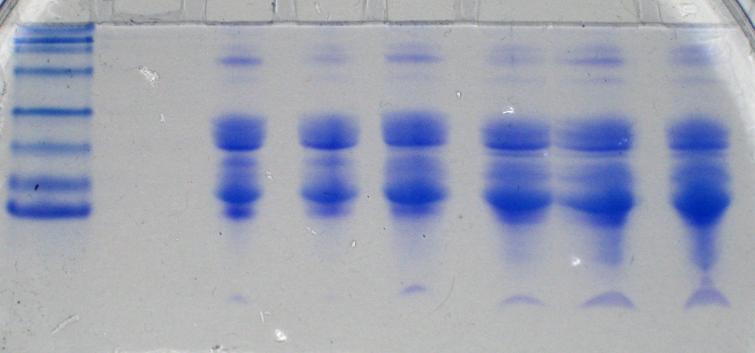
SDS PAGE Tricine
52
35
28
21
14
0%
0%
50%
50%
100%
100%

Slide 23
OPTYGRAPH
EFFECT OF ADDING increasing levels of phosphopeptide rich P-P TO BACTERIAL FREE MILK
CONTROL

Slide 24
Curd yield and clotting time of goat milk from
infected vs. uninfected udder-halves
Infected
Uninfected

Slide 25
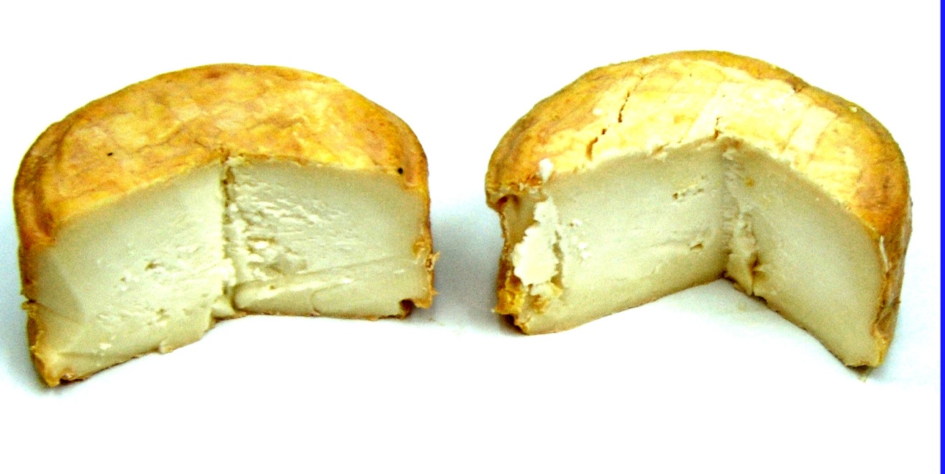
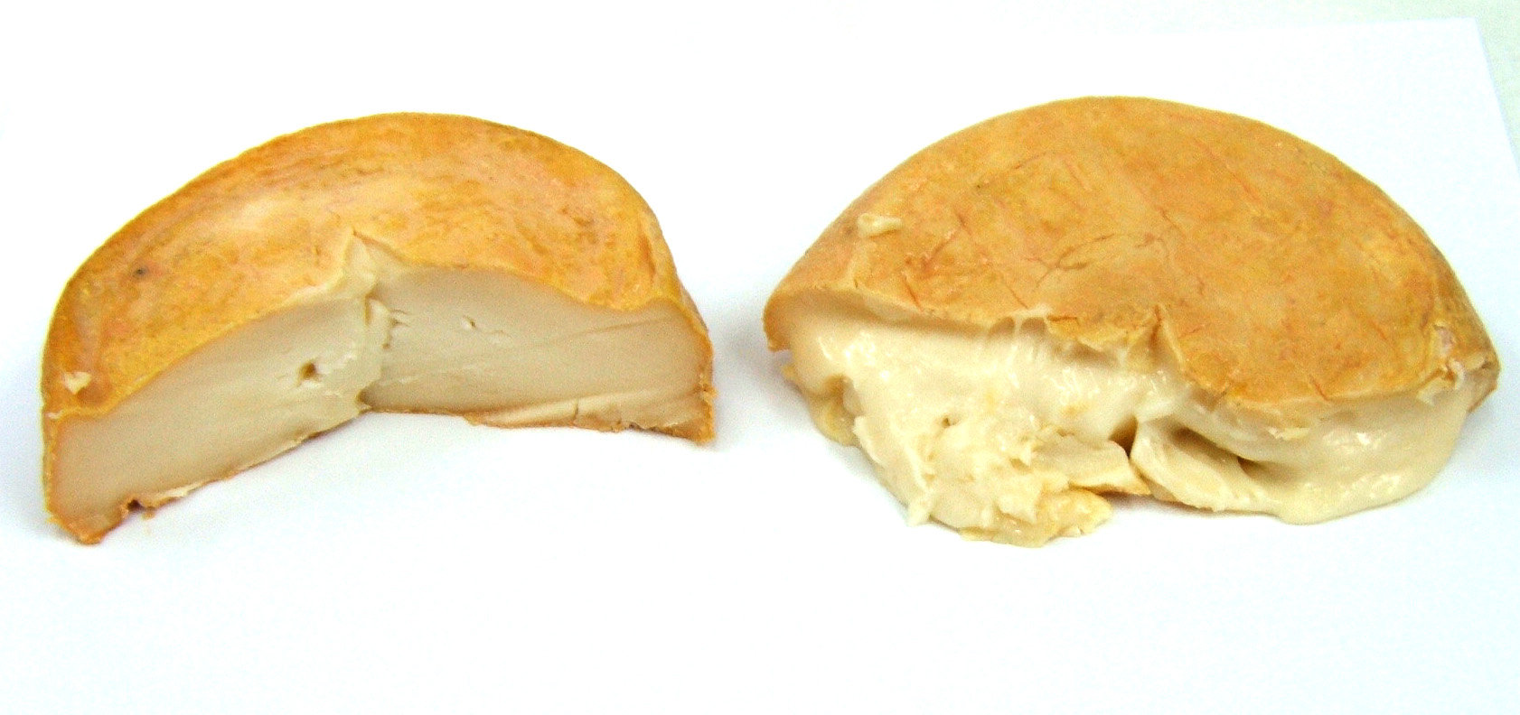
Healthy
Infected
Staph. chromogenes
Strep. dysgalactiae

Slide 26
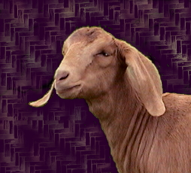
Milk yield and SCC along the
lactation
1000
3.5
Milk (K/day)
SCC (x 1000)
0.5
100
Days in milk

Slide 27
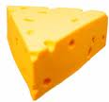
Curd firmness and clotting time in sheep
according to stage of lactation and IMI
Curd firmness (V)
Clotting time (sec)
ML-F = mid lactation free; ML-I = mid lactation infected; EL = end lactation

Slide 28
% lactose and Cf of curd of goat milk at mid lactation with and without IMI and at the end of lactation without IMI
Low quality curd
% Lactose
Lactose lower than
4%
Curd firmness (Cf)

Slide 29
Influence of percent lactose in milk on curd
firmness as measured by the Optigraph

Slide 30
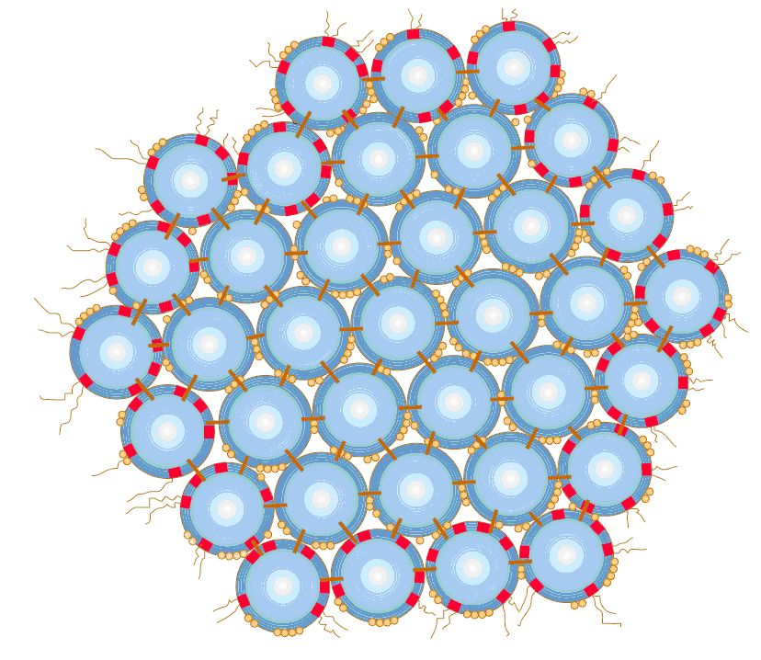
Anti-Lactogenic hormones
e.g., Cortisol, Estrogen
Lactogenic hormones e.g., GH, Prolactin
Blood
^{alveoli}
PA
Reaction
type 2
Reaction
type 1
Lumen
1
2
PLG
PL
Milk stasis or bacterial invasion
Frequent milking or suckling
External effects:
Milking, suckling, bacterial invasion

Slide 31
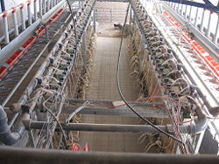
Traditional farming
Along the lactation different
products are produced
2. Milk from clinically infected glands is discarded
Modern dairy forming
Animals are milked while at
different stages of lactation
2. A large number of glands are infected with a variety of bacteria

Slide 32
Final Conclusion : 1
The present results provide dairies that process milk into cheese with new criteria ( i.e. Lactose concentration < 4%) that will enable them to identify and isolate milk that will not coagulate.
Such milk might still meet the criteria as drinking milk; therefore farmers will be able to exploit the milk they produce more economically.

Slide 33
On-line computerized milking systems enables genuine real-time data acquisition on individual animals with milk unsuitable for cheese making

Slide 34
Final Conclusion : 2
The effectiveness of lactose, % Casein, and SCC as predictors of milk quality for cheese production is impaired at the dairy tank level because of dilution of milk from subclinically infected glands with good-quality milk. However, the effect of subclinical mastitis on milk quality remained significant. Thus, future development of new techniques that will be sensitive to milk quality on the tank level, and therefore will enable large dairies to pay farmers for milk according to its designated quality (i.e., for drinking or cheese manufacture). In turn, individual on-line measurements of milk-quality parameters, particularly the level of lactose, will enable producers to identify animals that yield low-quality milk, and thereby to meet the dairies' top price-quality standards by separating milk according to its best properties, for cheese production or drinking, and thus to maximize their profit from the milk they sell.

Slide 35
Thank you: I hope that this lecture
will contribute to our ability produce
better dairy products

